Slide 1
Reference Types vs. value Types

Slide 2
Value Types
Value types are what we have been using in C++ I.
When we pass a value type, we “pass by value.”
OK, never mind pointers and references. Their contents are not passed by value. But the addresses are.
Value types hold the value they represent in their memory.
Primitives (int, float, etc) are also passed by value.
Pass by value simply means that the value of the variable is copied.

Slide 3
Reference Types
In an object-oriented language like Java, you create new, complex data types from simple primitives by creating a class.
Each class is a new Type. Instances of the class are accessed by their reference variable, which gives us a name to access it.
The reference variable contains the address of the object and “points” to the location of the object on the heap.
Therefore, when we pass a reference type, only the reference is copied, not the object it is pointing to.

Slide 4
Object Initialization
Reference types always point to objects (or null), and objects are always defined by classes.
Similar to native types, instance or class variables that are not explicitly initialized when they are declared will be assigned the default value of null.
Also, like native types, local variables that have a reference type are not initialized by default so you must set your own value before using them.

Slide 5
Car class Example
public class Car {
private String make = “Toyota”;
private int year = 2014;
private String color = “silver”;
} //plus methods for the class
//create johnCar
Car johnCar = new Car();
//Now copy johnCar to stacyCar:
Car stacyCar = johnCar;
//And paint stacyCar peach.
stacyCar.setColor(“Peach”);
Question 1:
What color is johnCar?
Would it make a difference
Question 2:
Would it make a difference if we said this?
Car stacyCar = new Car();
stacyCar = johnCar;

Slide 6
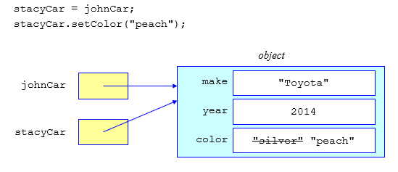
Assigning a Reference
The result of assigning one reference variable to another is that they then point to the same object.
With both reference variables pointing to the same object, if the object is updated by one of the reference variables, then the other reference variable will see the change and both cars will be peach.

Slide 7
How to copy reference variables so their objects are independent of each other
Instantiate a new object for the second reference and then assign the two objects' instance variables one at a time.
Car johnCar = newCar();
Car stacyCar = newCar(); //separate object
stacyCar.setMake(johnCar.getMake());
stacyCar.setYear(johnCar,getYear());
stacyCar.setColor(johnCar.getColor());
stacyCar.setColor(“peach”);

Slide 8
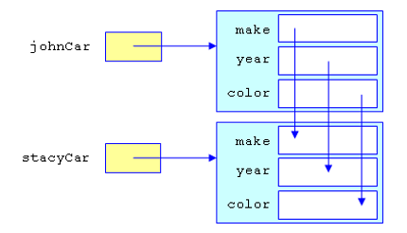
The Result – stacyCar is a separate object and when the car is painted peach, johnCar remains silver.

Slide 9
Passing References
Object references are passed to methods in the same way as functions.
In the original case, where stacyCar and johnCar refer to the same object, either one would serve as equivalent arguments:
myMethod(stacyCar);
An important, but sometimes confusing, distinction to make at this point is that the reference itself is a value and that value is copied when it is assigned to a variable or passed in a method call.
The method can alter the state of the stacyCar object through that reference (calling its methods or altering its variables).

